Slide 1
Cloud computing

Slide 2
What is cloud computing..
In simple terms, cloud computing is a range of services delivered over the internet, or “the cloud.” It means using remote servers to store and access data instead of relying on local hard drives and private datacenters.
Before cloud computing existed, organizations had to purchase and maintain their own servers to meet business needs. This required buying enough server space to reduce the risk of downtime and outages, and to accommodate peak traffic volume. As a result, large amounts of server space went unused for much of the time. Today’s cloud service providers allow companies to reduce the need for onsite servers, maintenance personnel, and other costly IT resources.

Slide 3
How does cloud computing work?
Put your data on cloud server.no need to buy expensive server or hard drive or disks to store data
Scalability your server capacity will vary accordingly to traffic how cool is that.
Your cloud provider will manage your server hence no need to worry we can pay for storage as much we need

Slide 4
Cloud models..
Service model
Deployment model

Slide 5
Service model
Software as a Service (SaaS)
Traditionally, software was installed directly on each individual device. With the software as service (SaaS) computing model, web applications are hosted in the cloud to reduce costs through pay-as-you-go pricing. End users can easily connect to the cloud application through a web browser or mobile device, and there’s no need for IT departments to get involved with management or maintenance. Examples include Gmail, Salesforce CRM, and Right Signature, as well as cloud storage services like OneDrive and Dropbox.

Slide 6
Platform as service (PaaS)
No control over the underlying architecture including operating system storage server etc.
The cloud provider gives the ability to customer to deploy customer created application using programming languages tools etc that are provided buy cloud provider.
infrastructure as service (IaaS)
The infrastructure as a service (IaaS) computing model moves an organization's entire datacenter to the cloud. The business rents virtual machines, virtual servers, operating systems, and other IT infrastructure on a pay-as-you-go basis. The cloud service provider is responsible for maintaining all data storage servers and networking hardware, eliminating the need for a resource-intensive, on-site installation. Examples include Microsoft Azure, Google Cloud, Oracle Cloud, and Amazon Web Services (AWS).

Slide 7
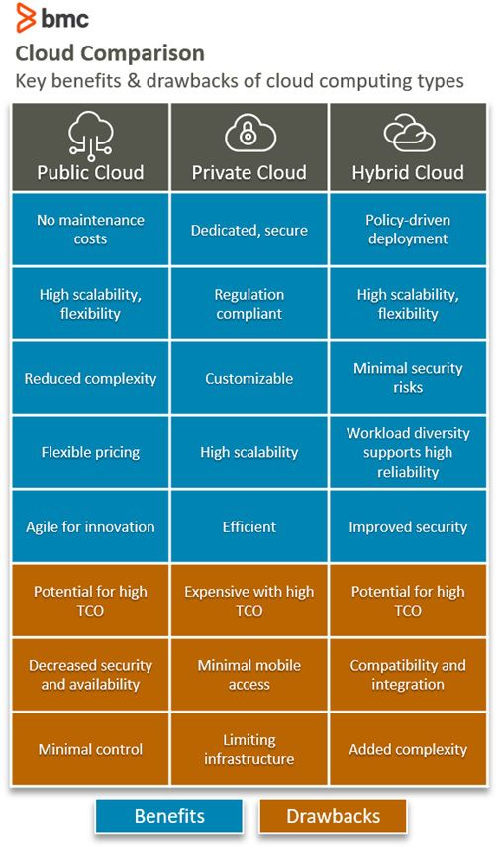
Deployment model

Slide 8
Benefits of cloud computing..
Cost Savings
Security
Flexibility
Mobility
Insight
Increased Collaboration
Quality Control
Disaster Recovery
Loss Prevention
Automatic Software Updates
Competitive Edge
Sustainability

